Slide 1
Azure AI Foundry E2E Lab — Comprehensive Workshop Deck Outline
Detailed guide to AI workshop setup and implementation
Notes:
AI-generated content may be incorrect. --- Welcome to the Azure AI Foundry End-to-End Lab workshop. This presentation provides a detailed outline of the workshop content, covering setup, core AI services, implementation phases, advanced capabilities, technical requirements, troubleshooting, and resources.

Slide 2
Workshop Schedule
Introduction and Setup Essentials
Core AI Services and Configuration
Workshop Phases I–IV: Foundational Implementation
Workshop Phases V–VIII: Advanced Capabilities
Technical Requirements and Developer Tools
Troubleshooting, Best Practices, and Community
References and Additional Resources
Notes:
We will begin with an introduction and setup essentials, followed by core AI services and configuration. Then, we will explore foundational and advanced implementation phases, technical requirements, troubleshooting tips, and finish with references and additional resources.

Slide 3

Introduction and Setup Essentials
Notes:
This section covers the initial workshop overview, objectives, authentication and setup process, and environment and kernel configuration to prepare for the lab activities.

Slide 4
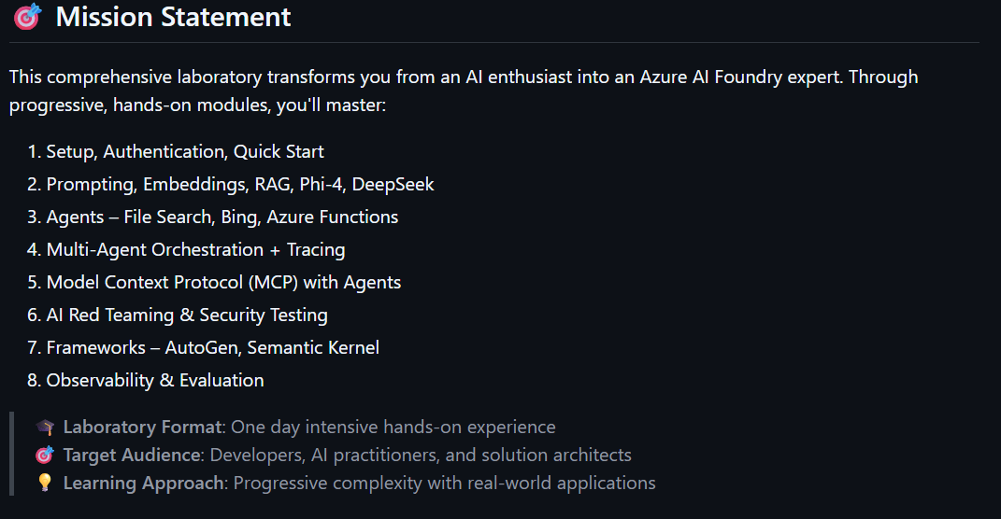

Slide 5
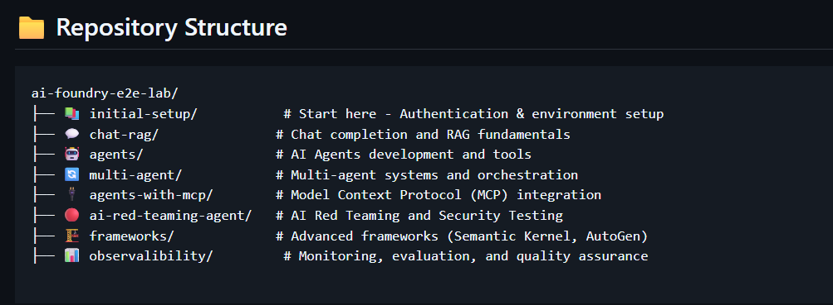

Slide 6

Authentication and Setup Process
Authentication Steps
Detailed steps to authenticate users for secure access to cloud-based Azure services.
Lab Environment Setup
Initial setup procedures to prepare the lab environment for Azure service usage and experimentation.
Notes:
--- We will guide you through the authentication steps required to access Azure services and the initial setup process for the lab environment. Image source: Microsoft 365 content library

Slide 7

Environment and Kernel Configuration
Environment Setup
Proper environment setup is essential to ensure compatibility and smooth operation of lab notebooks and code.
Kernel Configuration
Configuring kernel settings correctly helps in running code efficiently without errors or interruptions.
Notes:
--- This slide explains how to configure your environment and kernel settings to ensure smooth execution of the lab notebooks and code. Image source: Microsoft 365 content library

Slide 8

Core AI Services and Configuration
Notes:
Explore the core AI services used in the lab, including the models and services overview, environment variables setup, and Azure AI Search configurations.

Slide 9

Models and Services Overview
AI Model Integration
Azure AI Foundry integrates various AI models to enhance intelligent application development capabilities.
Support for Intelligent Apps
The services enable developers to build smarter applications with AI-powered features.
Notes:
--- An overview of the AI models and services integrated within the Azure AI Foundry to support intelligent application development. Image source: Microsoft 365 content library

Slide 10

Environment Variables for Configuration
Purpose of Environment Variables
Environment variables control the configuration and behavior of AI services in different environments.
Authentication Setup
Proper environment variable configuration is essential for secure authentication of AI services in labs.
Testing in Lab Environment
Lab environments use environment variables to simulate real AI service conditions for testing and development.
Notes:
--- Learn how to properly configure environment variables that drive the behavior and authentication of AI services in the lab environment. Image source: Microsoft 365 content library

Slide 11

Azure AI Search Settings
Indexing Configuration
Setup and customize the indexing process to organize and optimize searchable data effectively.
Querying Capabilities
Configure querying parameters to enable efficient and accurate retrieval of search results.
AI Model Integration
Integrate AI models to enhance search relevance with natural language processing and machine learning.
Notes:
--- This slide discusses the configuration of Azure AI Search, including indexing, querying, and integration with AI models. Image source: Microsoft 365 content library

Slide 12
Workshop Phases I–IV: Foundational Implementation
Notes:
This section covers the foundational phases of the workshop, focusing on initial setup, Retrieval-Augmented Generation, agent integration, and multi-agent orchestration workflows.

Slide 13
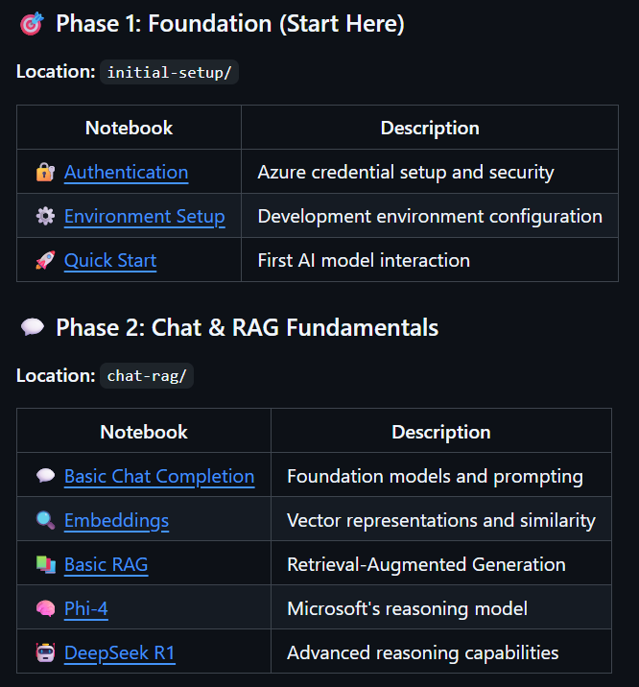

Slide 14
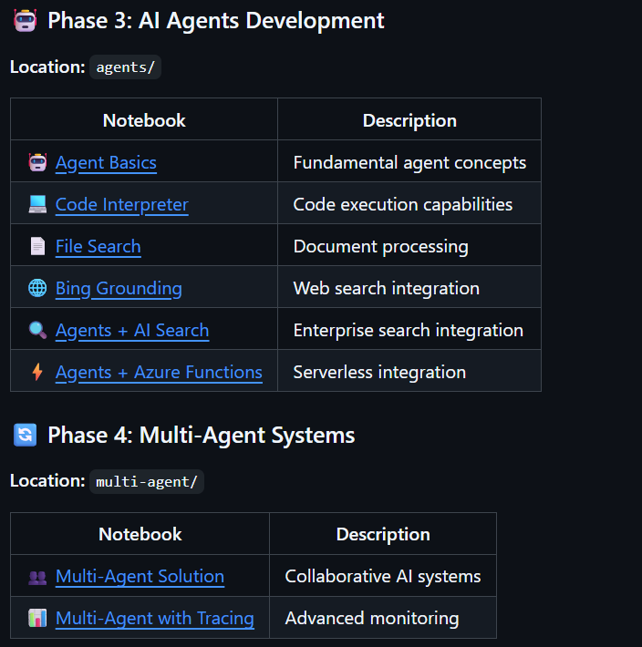

Slide 15

Phase 1: Initial Setup and Prerequisites
Setup Essential Tools
Prepare all necessary software and hardware tools to start the lab effectively.
Verify Prerequisites
Ensure all prerequisite services and components are installed and properly configured.
Notes:
--- Phase 1 covers the essential setup and prerequisites needed to begin the lab, ensuring all tools and services are ready for use. Image source: Microsoft 365 content library

Slide 16
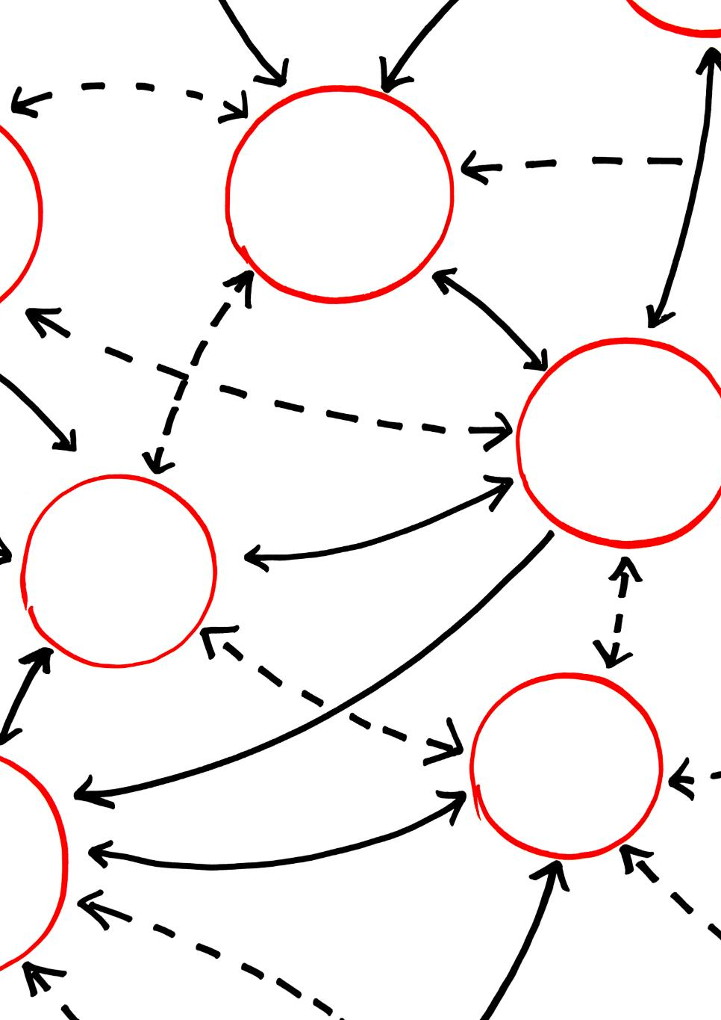
Phase 2: Chat-RAG — Retrieval-Augmented Generation
Retrieval-Augmented Generation Overview
RAG combines pre-trained language models with retrieval systems to access external knowledge dynamically.
Enhancing Chat Models
RAG improves chat models by providing contextually relevant information from external sources during conversations.
Integration of Knowledge Sources
External knowledge sources are accessed in real-time to augment generation, improving response accuracy and relevance.
Notes:
--- An explanation and diagram illustrating how Retrieval-Augmented Generation (RAG) enhances chat models with external knowledge sources. Image source: Microsoft 365 content library

Slide 17

Phase 3: Agent Integration
AI Agent Tools Integration
Various AI agent tools are integrated to enhance functionalities within the lab environment.
Extended Lab Capabilities
Integration extends lab capabilities by enabling advanced AI-driven operations and workflows.
Notes:
--- This slide presents a diagram and overview of integrating various AI agent tools to extend capabilities within the lab environment. Image source: Microsoft 365 content library

Slide 18

Phase 4: Multi-Agent Orchestration
Multi-Agent Coordination
Multiple agents collaborate seamlessly to achieve integrated workflow objectives.
Workflow Integration
Diagrams illustrate how workflows are integrated to optimize process efficiency.
Notes:
--- Explore the orchestration of multiple agents working together through diagrams that depict workflow integration and coordination. Image source: Microsoft 365 content library

Slide 19
Workshop Phases V–VIII: Advanced Capabilities
Notes:
Delve into advanced lab phases covering multi-component processing, red-teaming and security, extensibility frameworks, and observability and evaluation techniques.

Slide 20
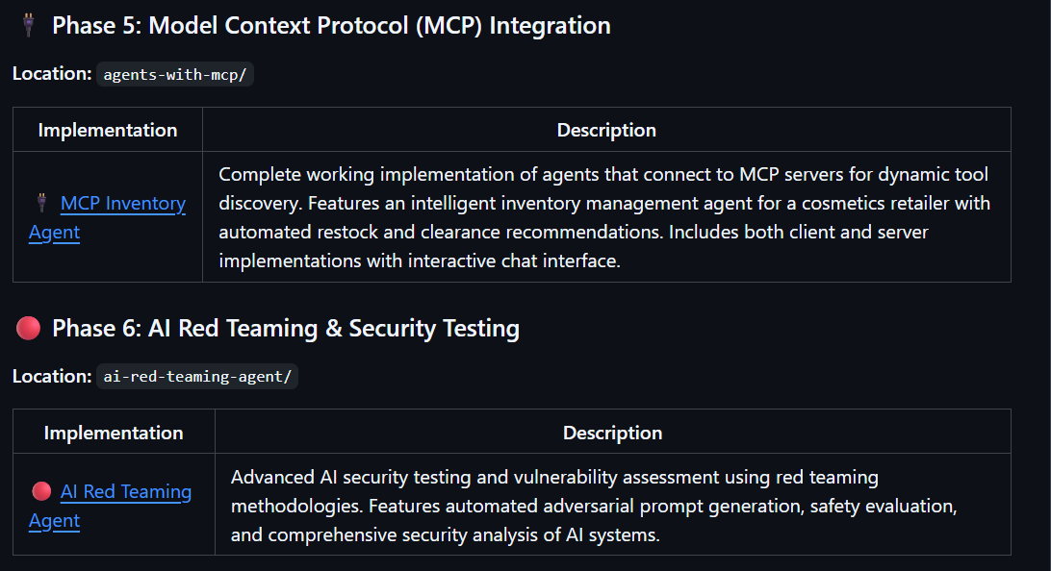

Slide 21
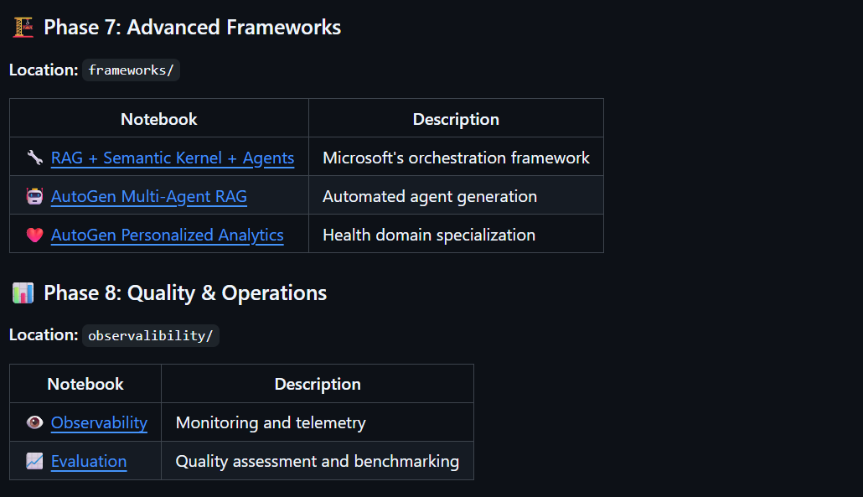

Slide 22
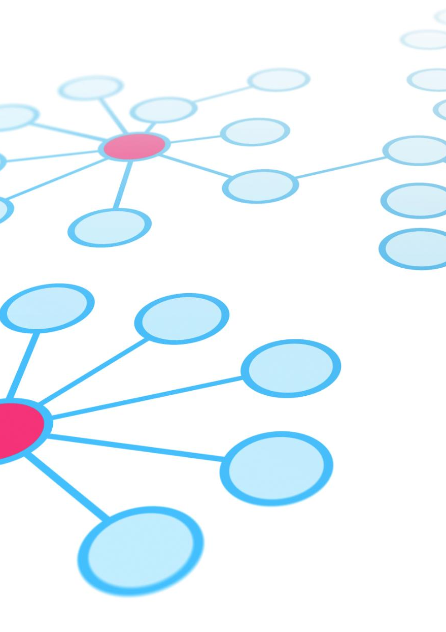
Phase 5: MCP (Model Context Protocol)
Overview of MCP
Model Context Protocol integrates various AI modules to work together seamlessly for complex tasks.
Collaborative AI Components
Different AI components collaborate dynamically to enhance processing capabilities and outcomes.
Sophisticated Outcome Delivery
MCP enables delivery of advanced results by leveraging multiple intelligent components working in unison.
Notes:
--- An overview and diagram of Multi-Component Processing, demonstrating how different AI components collaborate to deliver sophisticated outcomes. Image source: Microsoft 365 content library

Slide 23

Phase 6: Red-Teaming and Security Considerations
Red-Teaming Practices
Red-teaming simulates attacks to identify vulnerabilities in AI systems before deployment.
Security Measures
Implementing strong security protocols ensures AI systems operate safely and reliably.
Safe AI Deployment
Combining red-teaming and security safeguards supports responsible and robust AI deployment.
Notes:
--- Discuss red-teaming practices and security measures to ensure robust and safe AI deployment within the lab environment. Image source: Microsoft 365 content library

Slide 24

Phase 7: Frameworks and Extensibility
Framework Utilization
Frameworks in the lab provide structured foundations for streamlined development and scalability.
Extensibility Support
Extensibility allows custom development and integration to enhance lab functionalities and adaptability.
Notes:
--- This slide highlights the frameworks used in the lab and how they support extensibility for custom development and integration. Image source: Microsoft 365 content library

Slide 25

Phase 8: Observability and Evaluation
Monitoring Tools
Explore various tools designed to continuously monitor AI system performance and detect anomalies in real-time.
Observability Methods
Understand methods that provide insights into AI system behavior, enabling better transparency and issue diagnosis.
Performance Evaluation
Learn techniques for evaluating AI system accuracy, efficiency, and overall effectiveness throughout its lifecycle.
Notes:
--- Learn about tools and methods for monitoring, observability, and evaluating AI system performance throughout the workshop phases. Image source: Microsoft 365 content library

Slide 26

Troubleshooting, Best Practices, and Community
Notes:
Focus on common troubleshooting scenarios, best practices to maximize lab success, and how to engage with the community for support and collaboration.

Slide 27

Troubleshooting Common Issues
Identify Frequent Issues
Recognize common problems that occur regularly during lab sessions to address them effectively.
Practical Solutions
Apply proven techniques and methods to quickly resolve identified issues and minimize downtime.
Notes:
--- Identify frequent issues encountered during the lab and practical solutions to resolve them quickly. Image source: Microsoft 365 content library

Slide 28
Best Practices for Lab Success
Preparation and Planning
Thoroughly review lab materials and plan your approach before starting to enhance efficiency and understanding.
Active Participation
Engage actively in experiments and discussions to maximize learning and troubleshoot effectively.
Safety and Accuracy
Follow safety protocols meticulously and record data precisely to ensure reliable results and prevent accidents.
Notes:
--- Recommendations and tips to ensure smooth progress and effective learning throughout the workshop. Image source: Microsoft 365 content library

Slide 29
References and Additional Resources
Notes:
A collection of reference materials, official documentation, and further learning resources to deepen understanding beyond the workshop.

Slide 30

Reference Materials and Documentation
Essential Documentation
Key documents provide comprehensive guidance on Azure AI Foundry components and their functionalities.
Guidance and Tutorials
Tutorials and guides help users effectively understand and implement Azure AI Foundry components.
Reference Links
Curated links connect users to additional resources and official documentation for further study.
Notes:
--- Links and descriptions of key documents and materials essential for understanding and working with Azure AI Foundry components. Image source: Microsoft 365 content library

Slide 31

Further Learning Resources
Tutorials and Courses
Structured tutorials and courses provide step-by-step guidance to master Azure AI technologies effectively.
Community Forums
Community forums offer peer support, knowledge sharing, and troubleshooting for continued learning.
Notes:
--- Additional resources such as tutorials, courses, and community forums to support continued learning and mastery of Azure AI technologies. Image source: Microsoft 365 content library

Slide 32
Summary and Next Steps
Workshop Completion
The workshop provided a comprehensive overview of Azure AI Foundry's end-to-end lab experience.
Encouragement to Engage
Participants are urged to actively engage with materials and resources to deepen AI knowledge.
Advancing AI Expertise
Leveraging available resources will help users advance their skills and expertise in AI technologies.
Notes:
This concludes the comprehensive outline of the Azure AI Foundry E2E Lab workshop. We encourage you to explore the materials, engage actively, and leverage the resources to advance your AI expertise.

